Slide 1


Slide 2
Topics to be covered
Last class we saw how to deal with hard and soft margin SVM problems
In this class we will see how to deal with non linear SVM (Kernel Trick)
We will go through one nonlinear example: XOR problem
We will see Examples for soft margin SVM using the slack variables (Covered in the last lecture)
We will see Examples for soft margin SVM iusing hings loss function (Covered in last lecture)
6.

Slide 3
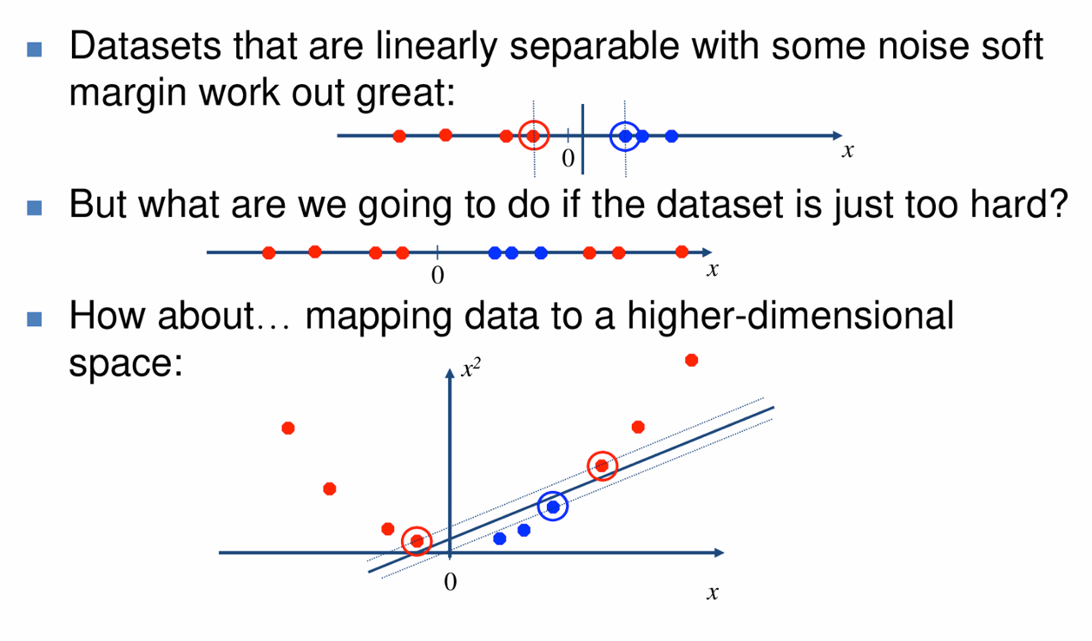
Nonlinear SVM

Slide 4
Kernel Functions
A kernel function is some function that corresponds to an inner product in some expanded feature space.
K (x_{i} , x_{j} ) = ϕ(x_{i} )^{T} ϕ(x_{j} )
Linear classifier relies on dot product between vectors x ^{T} x_{j}
i
If every data point is mapped into high-dimensional space via some transformation ϕ : x → ϕ(x ), the dot product becomes: K (x_{i} , x_{j} ) = ϕ(x_{i} )^{T} ϕ(x_{j} )
For some functions K (x_{i} , x_{j} ) checking K (x_{i} , x_{j} ) = ϕ(x_{i} )^{T} ϕ(x_{j} ) is difficult.
Mercer’s theorem: Every positive-semidefinite symmetric function is a kernel function.

Slide 5
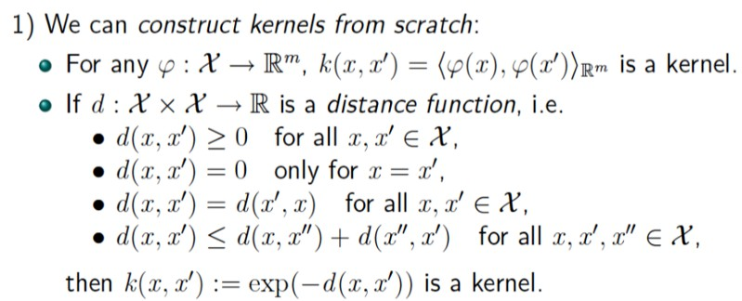
Kernel Functions Construction

Slide 6
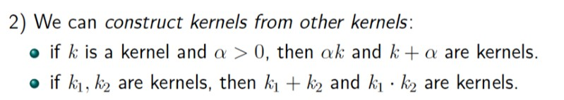
Kernel Functions Construction
Examples of Kernels
Linear: K (x_{i} , x_{j} ) = x ^{T} x_{j}
i
Polynomial of power p : K (x_{i} , x_{j} ) = (1 + x ^{T} x_{j} )^{p}
i
Sigmoid: K (x_{i} , x_{j} ) = tanh(β₀x ^{T} x_{j} + β₁)
i

Slide 7
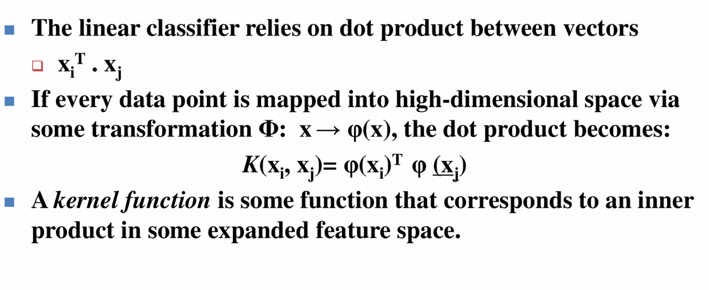
The Kernel Trick

Slide 8
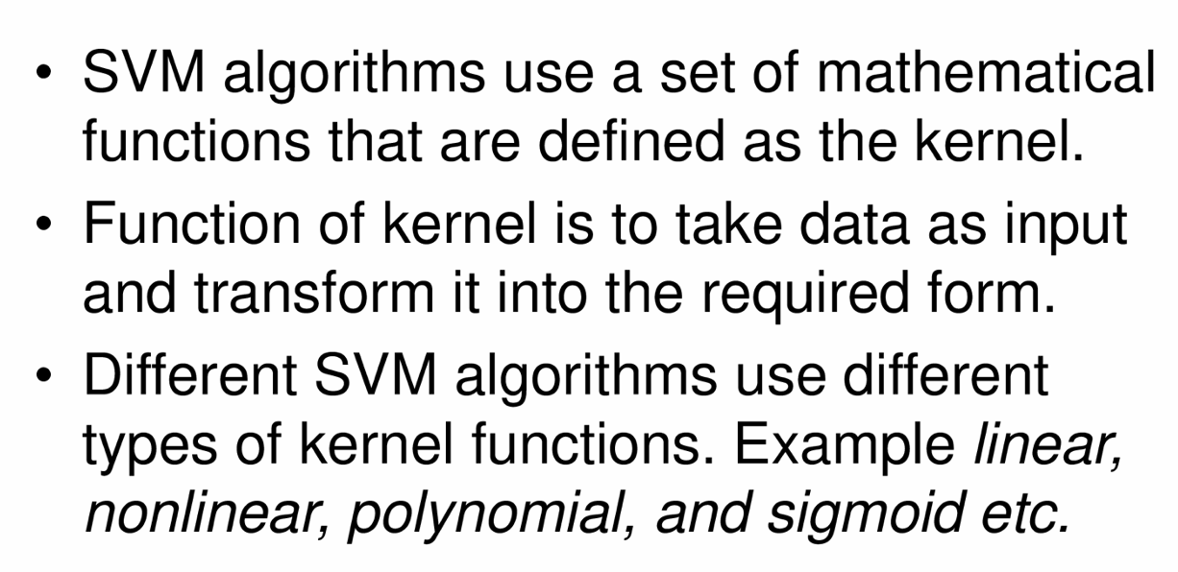
SVM Kernels

Slide 9
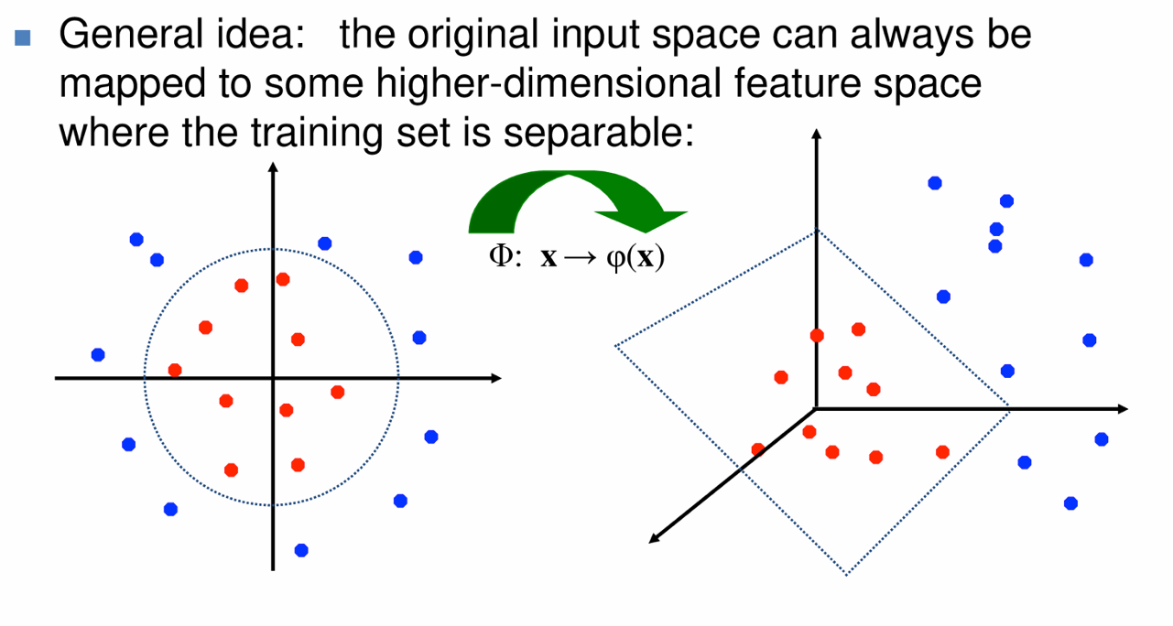
Nonlinear SVM – Feature Spaces

Slide 10
Steps to solve nonlinear SVM
Select a kernel function.
Compute pairwise kernel values between labeled examples.
Use this “kernel matrix” to solve for SVM suppoi1 vectors & alpha weights.
To classify a new example: compute kernel values between new input and suppoi1 vectors, apply alpha weights, check sign of output.

Slide 11
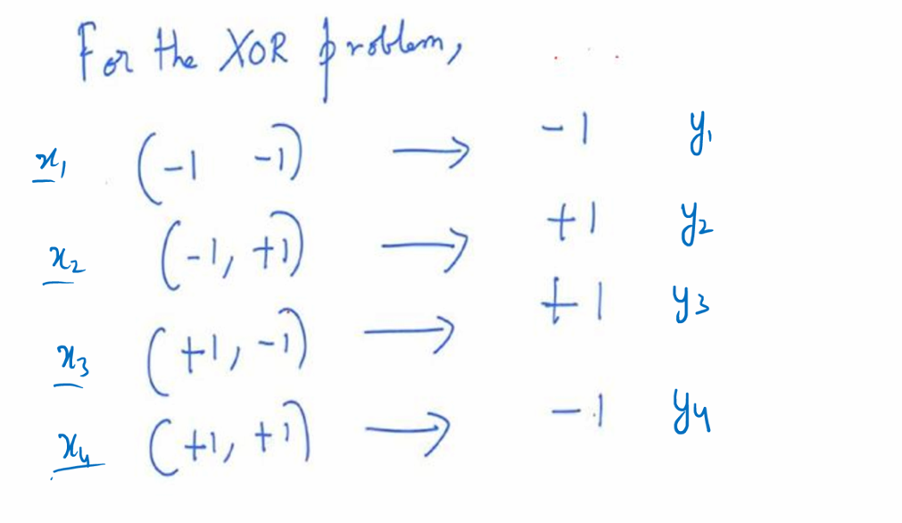
Non linear SVM – XOR Problem

Slide 12
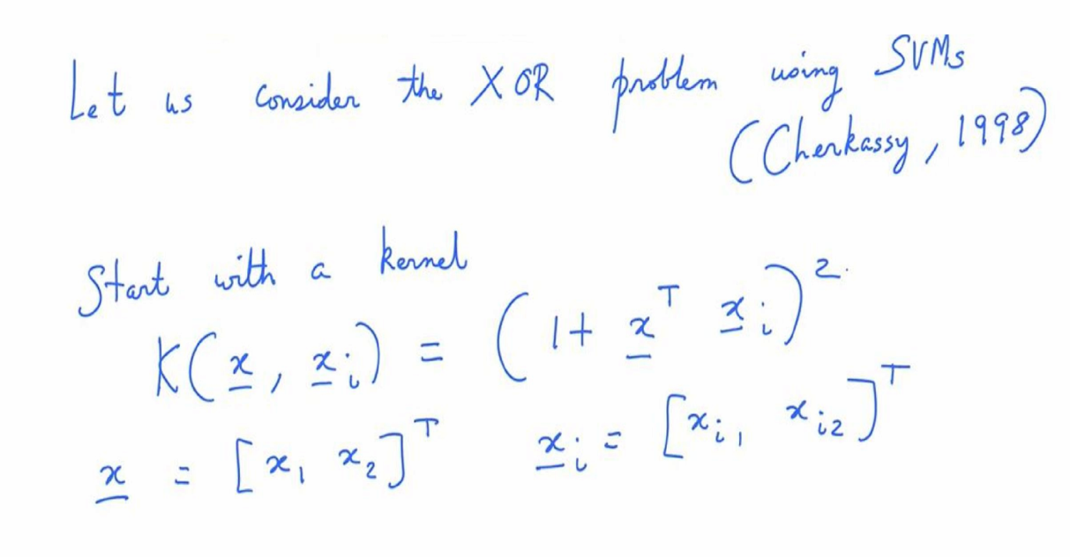
Choose the kernel for XOR problem

Slide 13
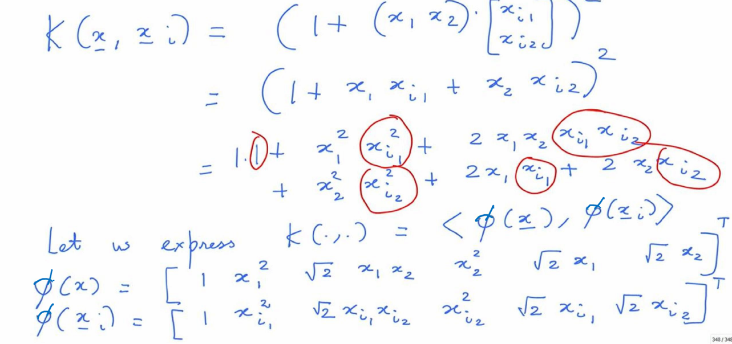
Expressing the kernel as inner product of two phi functions

Slide 14
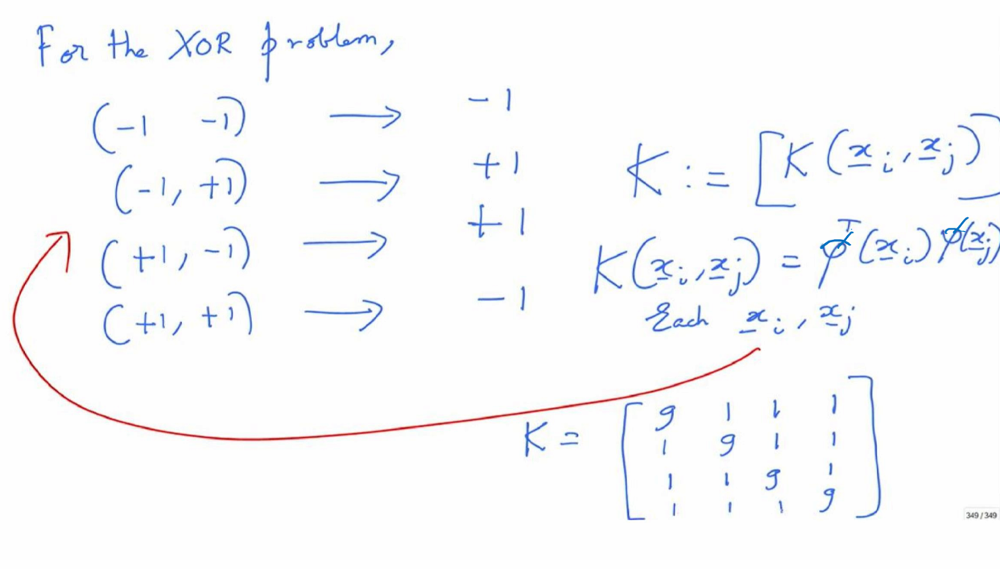
Computing the Kernel matrix

Slide 15
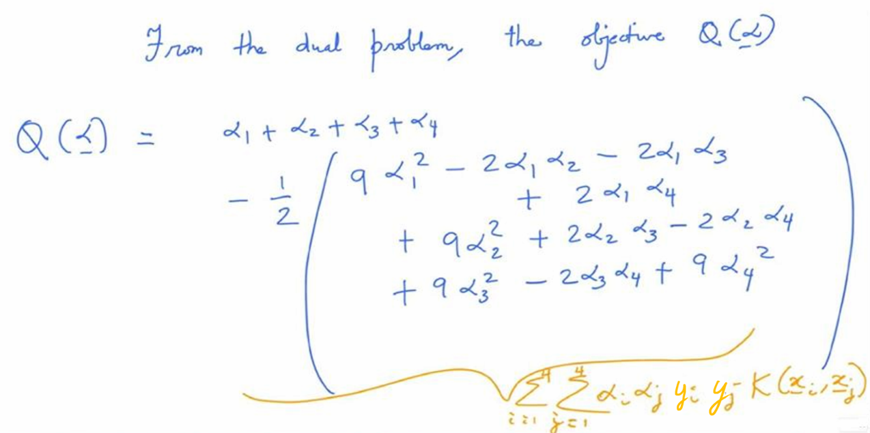
The Objective function in the dual probelm

Slide 16
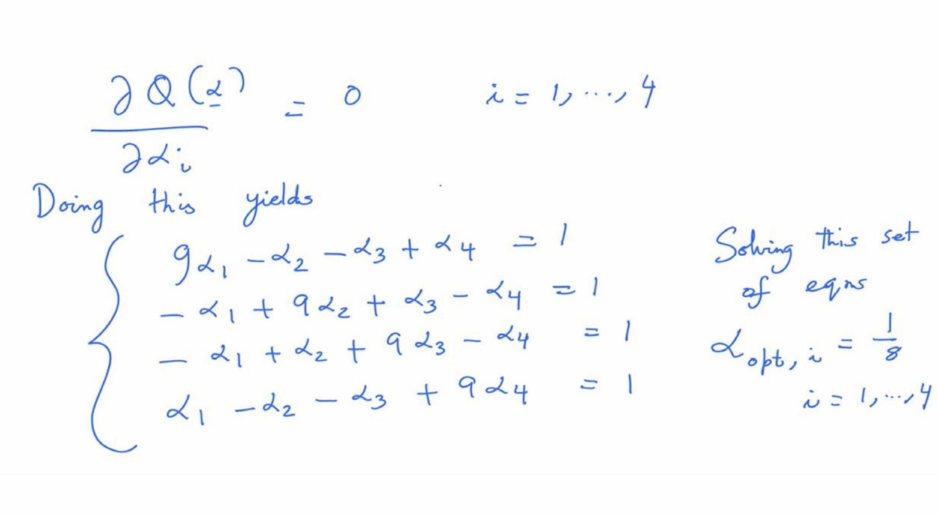
Solving for αs

Slide 17
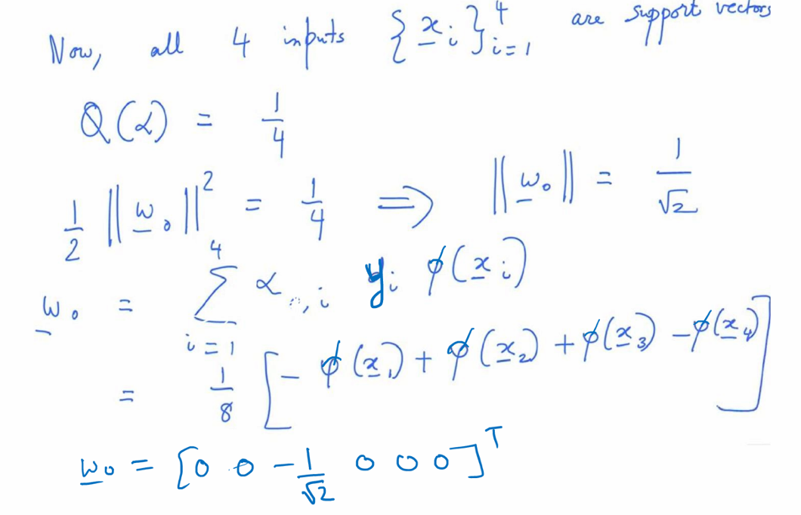
Computing w₀

Slide 18
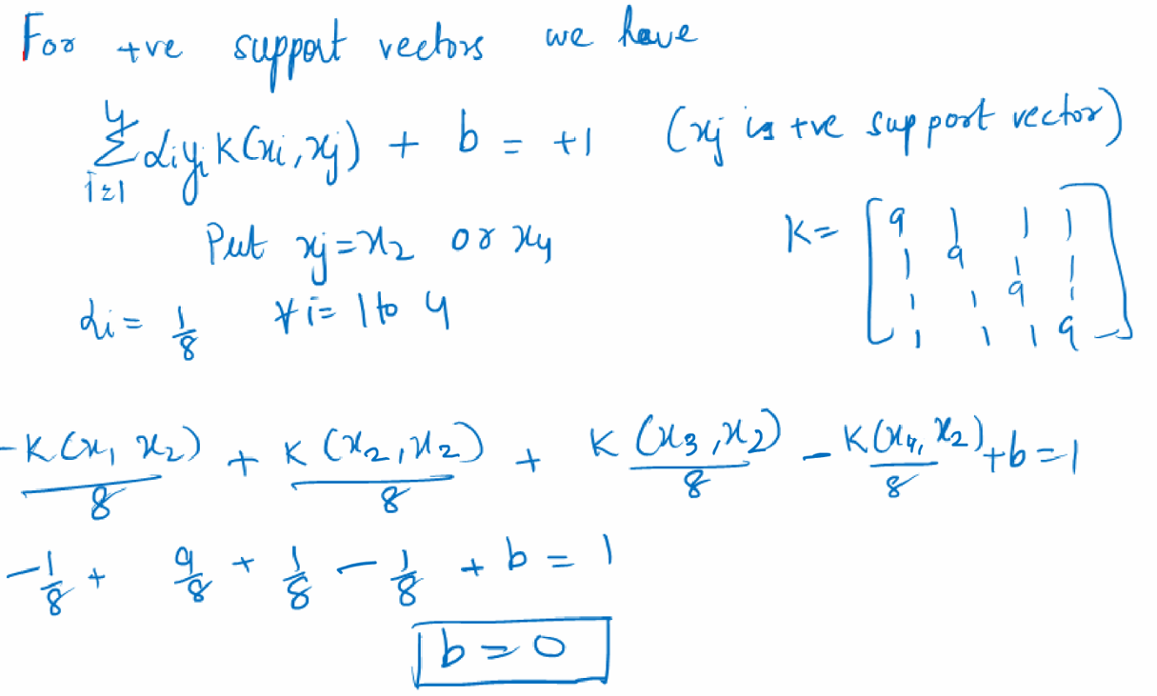
Computing b

Slide 19
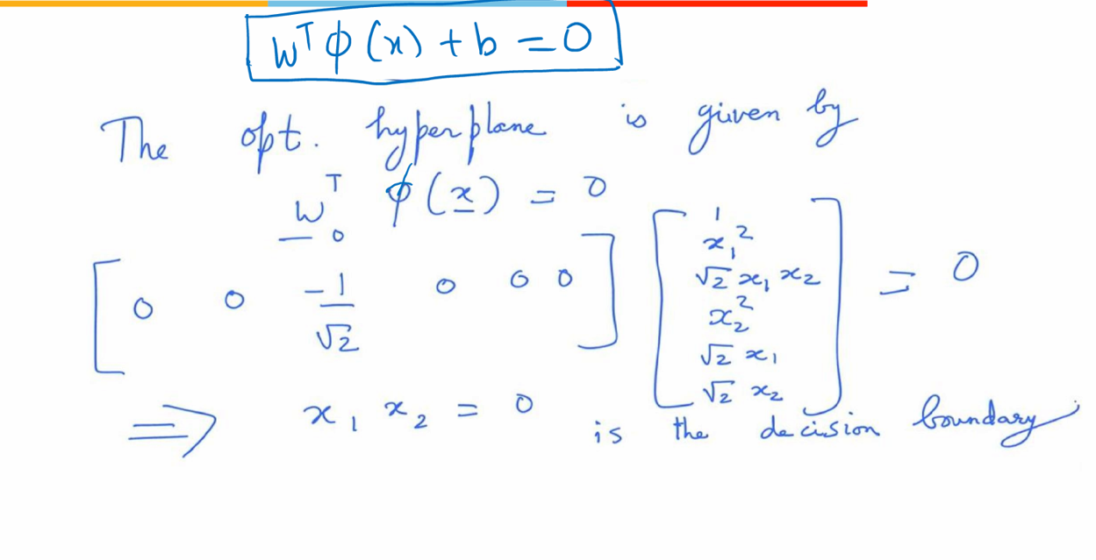
Decision Boundary for XOR problem

Slide 20
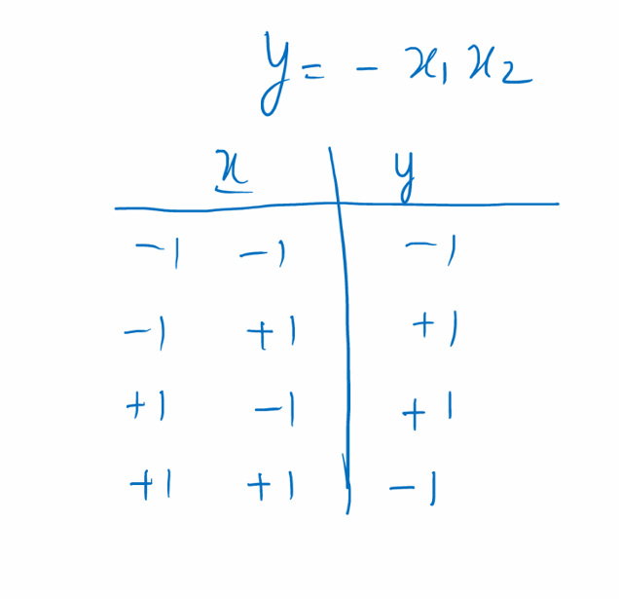
Non linear Decision Boundary

Slide 21
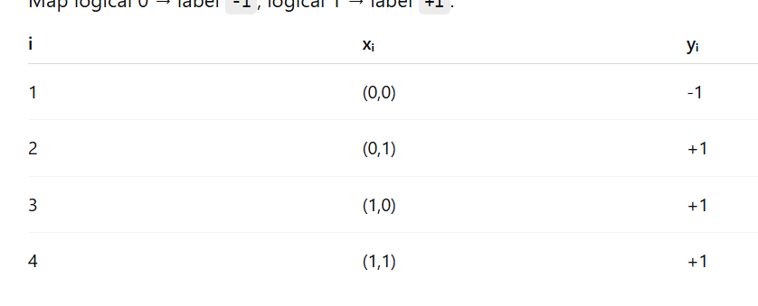
SVM for OR logic FUnction
The OR dataset is actually linearly separable. A simple separating hyperplane is: wx + b = 0 where
w=[1,1], b=−0.5.
Question: Find out the equation of the hyper plane that maximizes the margin.

Slide 22
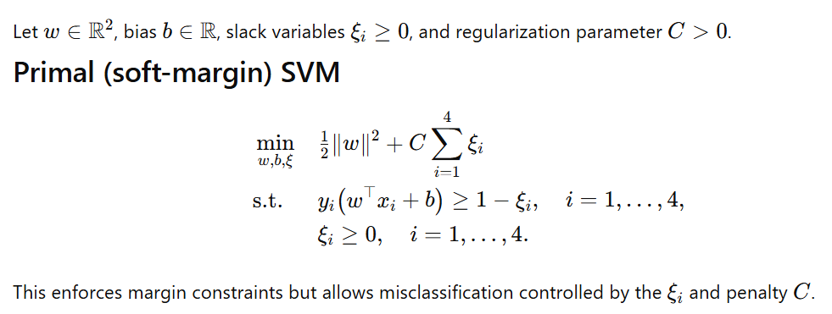
Soft Margin SVM for the OR Logical Function

Slide 23
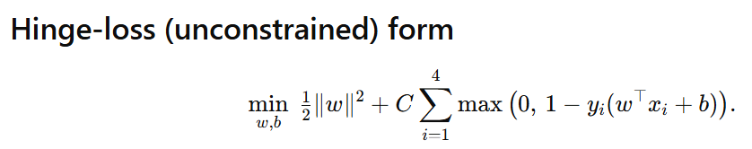
Hinge-Loss Function

Slide 24
